Slide 1
Smart Street light management using ibm Watson
by:
Sanjana karra
S.s.Harshitta
Rayeesa ruhi

Slide 2
Smart street light management
Smart street lights can transform the way municipalities manage cities, while delivering enormous savings.
Managing street lights are usually very costly to operate and they use in average 40% of a city’s electricity spending.
They can also be set to turn on only when they detect motion, and then dim or turn off after a specific amount of time
Smart street lights contribute to more livable cities by helping to improve safety and reduce congestion.

Slide 3
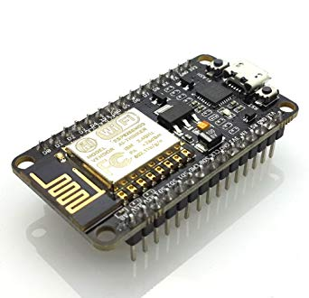
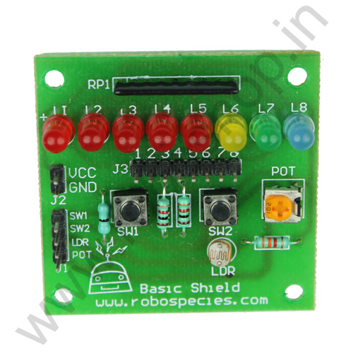
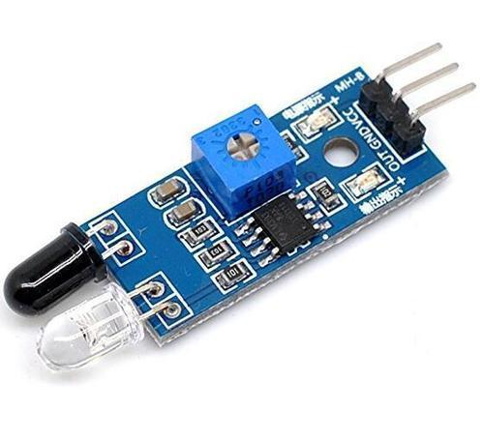
hardware : NODE MCU,BASIC SHIELD,IR SENSOR

Slide 4



Software: Arduino IDE , MIT App Inventor 2 , IBM Watson Cloud Services

Slide 5
Hardware and Software used
HARDWARE
NODE-MCU – with Wi-Fi module is ESP8266 12E is used .
LDR - is a light-controlled variable resistor .
LED – is a light-emitting diode .
IR Sensor – to detect motion of vehicles .
SOFTWARE
Arduino IDE – with embedded C programming is used to program .
MIT App Inventor 2 – create an app to send and receive data .
IBM Watson Cloud Services – Store the data .

Slide 6
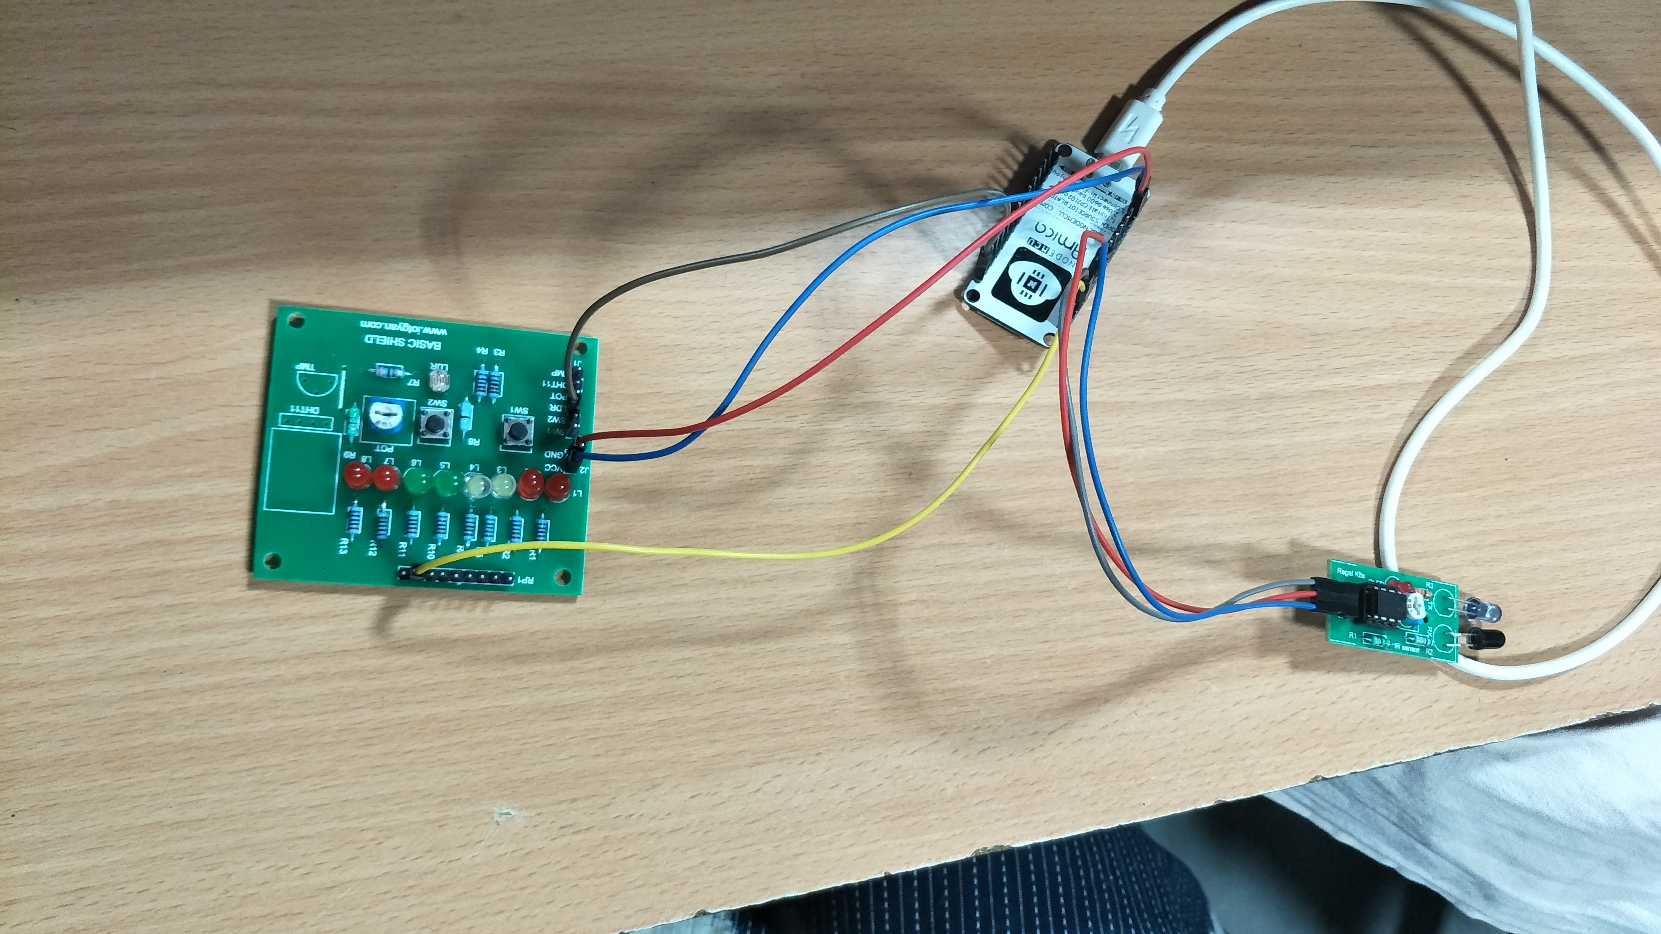
connections:

Slide 7
Programming:
LDR(Light Dependent Resistor)- It is a variable resistor and changes its resistance in a proportion to the light exposed to it.
It’s resistance decreases with the intensity of light.
The attached LED glows in analog mode according to the LDR Values.
The attached LED remains OFF for all the values below Threshold limit. You can set your own threshold limit. In this programme we have given 800 as threshold. You can set the threshold to any value between 0 and 1023.

Slide 8
IBM WATSON :
Connecting Node MCU with IBM Cloud using Arduino Programming
Stores the command send and the value of resistor .
Creating a Node RED UI to receive and send data to the device .

Slide 9
Mit app inventor 2:
Individual and Area wise Street lights can be controlled.
The required street lights can even be made dimmer .
Reduces Manual effort .
Accessing Sensor data from anywhere in the world .

Slide 10
CONCLUSION:
Smart lighting is transforming the way cities and utility providers view street lights. Converting to smart street lights can save energy and cost over simple LEDs. With smart street lights, however, cities can realize significant benefits.

Slide 11
Thank you.
When its bright , Switch off the lights .

